Slide 1





There are many simple things you can do to minimize your carbon footprint and negative impact on the environment. Click through the tabs to learn more.

Slide 2
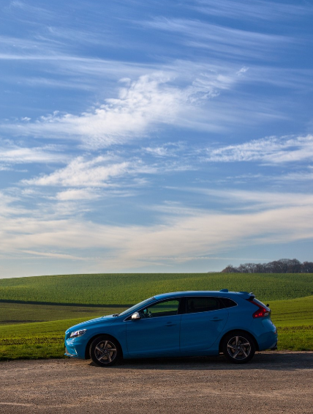
Driving
Use driving alternatives
Tire inflation and tuning
When possible, walk or ride your bike in order to avoid carbon emissions completely. Carpooling and public transportation drastically reduce CO2 emissions by spreading them out over many riders.
Properly inflated tires may improve your gas mileage by 3% o more. It also helps to use the correct grade of motor oil, and to keep your engine tuned. Certain maintenance fixes, like fixing faulty oxygen sensors, can increase fuel efficiency by up to 40%.
Drive fuel efficient vehicles
Driving style
All vehicles have an estimated miles-per-gallon rating. Electric cars still have carbon emissions because they’re usually charged with electricity created by the burning of fossil fuels; however, their MPG equivalents are typically much higher than conventional and hybrid cars.
Speeding and unnecessary acceleration reduce mileage by up to 33%, waste gas and money, and increase your carbon emissions.

Slide 3

Air Travel
General Tips
Until petroleum-based aviation fuel is replaced, you should avoid flying when possible, fly less frequently, fly shorter distances, and fly economy class.
Limit air travel Take fewer and longer vacations that are far away, and more frequent and driveable “staycations” closer to home. Increase your use of video-conferencing tools like Skype and Facetime for work.
Fly economy class Economy class is best, for the same reasons as carpooling and public transportation. Each flyer’s share of a flight’s carbon emissions is relatively less because it’s spread out over more people.

Slide 4



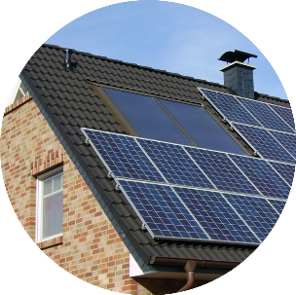
Home Energy
Home Insulation
Lighting
Reduce drafts and air leaks with caulk, insulation, and weather stripping. Many cities offer programs and incentives to facilitate this.
Turn off lights you’re not using and when you leave the room. Replace incandescent light bulbs with compact flourescent or LED ones.
Appliances
Solar Panels
Make energy efficiency a primary consideration when choosing new appliances like furnaces, air conditioning units, dishwashers, and refrigerators. ENERGY STAR labeled products are recognized as having superior energy efficiency.
Make energy efficiency a primary consideration when choosing new appliances like furnaces, air conditioning units, dishwashers, and refrigerators. ENERGY STAR labeled products are recognized as having superior energy efficiency.

Slide 5
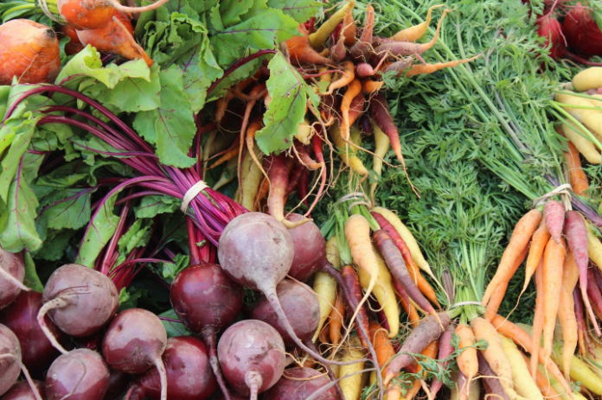
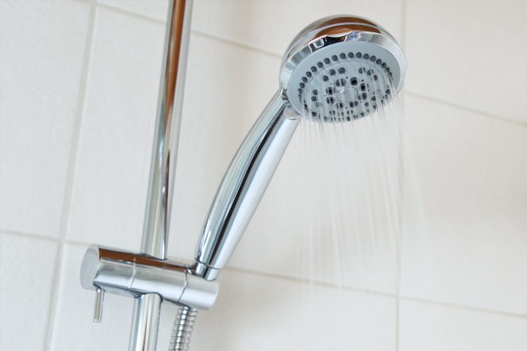
Other
Reuse and recycle
It has been estimated that 29% of U.S. greenhouse gas emissions result from the “provision of goods,” which means the extraction of resources, manufacturing, transport, and final disposal of “goods” which include consumer products and packaging, building components, and passenger vehicles, but excluding food.
By buying used products and reselling or recyling items you no longer use, you dramatically reduce your carbon emissions from the “provision of goods.”
Water usage
Lower the amount of energy used to pump, treat, and heat water by washing your car less often, using climate-appropriate plants in your garden, installing drip irrigation so that plants receive only what they need, and making water-efficient choices when purchasing shower heads, faucet heads, toilets, dishwashers and washing machines.
Food
It has been estimated that 13% of U.S. greenhouse gas emissions result from the production and transport of food.
Buy local and eat a more diversified diet including less meat and dairy to reduce your carbon emissions resulting from the use of fossil fuel-based fertilizers, pesticides, and gas required to produce and transport of the food you eat.

